Slide 1
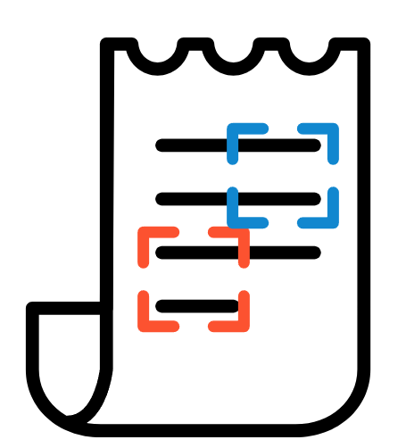
Receipt Mate
박찬호, 박현찬, 정우섭, 하승원, 허찬용

Slide 2
Table of contents
Team Organization
Background
Target
Problems
Solutions & Features
Flow Diagram & User Interface
Architecture
8. Plan & Implementation
Frontend
OCR Model
Backend
9. Deployment to Cloud
10. Demo
11. Test Result
12. Conclusion
Notes:
This is our contents as listed on the screen.

Slide 3
Team Organization
Name | Role | Tech Stack | Contribution
박찬호 | Team Leader, Frontend, Backend | Spring Boot, Flutter | Design (Features, Structure, Figma, Userflow diagram, Logo), Assisting Lambda deployment, Implementation and deployment of HTTP API Server, Implementation of Frontend screens
정우섭 | Frontend | Flutter | Code style convention for Flutter, Configuration of Flutter baseline codes, Implementation of Frontend screens,
하승원 | OCR Model | PyTorch, Layoutlmv3 | Labeling work using the collected data, Collected OCR result from receipts, Embedding and preprocessing of OCR data, Training and evaluating Layoutlmv3 model, Lambda deployment
허찬용 | OCR Model | PyTorch, Layoutlmv2 | Labeling work using the collected data, Collected OCR result from receipts, Embedding and preprocessing of OCR data, Training and evaluating Layoutlmv2 model,

Slide 4
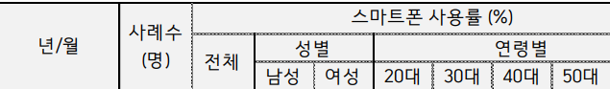

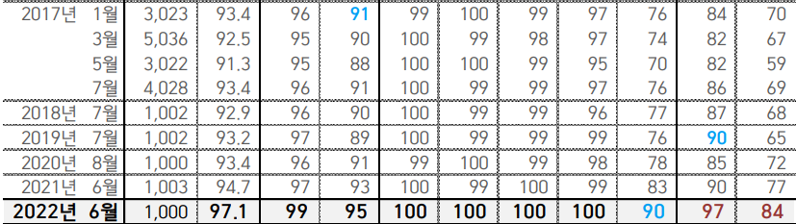
Background
Most of the people use smartphone (97.1%)
Increasing number of consumption management services
Only depending on electronic transaction record
ex) “MyData”
ref: https://www.gallup.co.kr/dir/GallupReport/GallupReport(20220706)_%EC%8A%A4%EB%A7%88%ED%8A%B8%ED%8F%B0.pdf
Notes:
As you know almost all people use smartphone. Along this trend, number of consumption management that uses smartphone is also increasing.
Those services get electronic record and then provide consumption management feature to users

Slide 5
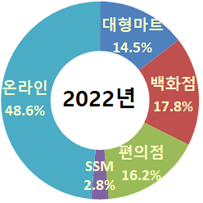
Target
Offline consumption is more than a Half
60.4% of consumers thought consumption management is important but only 33.6% of consumer wrote the book accounts (inconvenient and unfamiliar)
Target -> Offline consumption management
https://www.itbiznews.com/news/articleView.html?idxno=73524
Notes:
The figure on the slide shows that offline consumption is more than a half of all consumptions. As you know, consumption trend is shifting from offline to online, but offline market is still important, because people prefer experience consumption.For example, when consumers buy clothes they want to wear, they make sure they are fit or not.

Slide 6
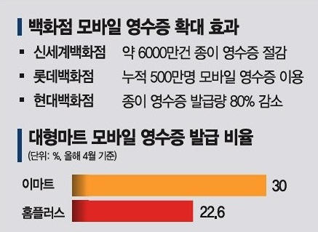
Problems
Mobile Receipts
○ About 70% Receipts are still Paper
○ Mobile receipts usage will increase but companies use different mobile receipts app
Card history
○ Services cannot manage the consumption detail but only the total cost.
2022.04
ref: http://www.casenews.co.kr/news/articleView.html?idxno=11329
Notes:
Still, there are some problems for offline consumption management. Existing services can’t manage the offline consumption well. That is caused by two reasons. First is weak utilization of electronic receipts. Look at that figure on the presentation we can see mobile receipt usage rate that is only 30%. Rest of receipts are paper .Also, company that supports mobile receipts require to user to use different apps. So, it’s hard to provide integrated consumption data to users. Second, services that handles offline consumption uses card history, which has only total cost as record, so consumer can’t manage the consumption details.

Slide 7
Solution & Features
Solution : OCR for paper receipt → convert to tabular data
Features
Our service convert paper receipts to tabular data using OCR.
Our service provides a sheet function that help users can modify tabular data.
Visualize tabular data with histograms or line plots.
Notes:
So, we propose ‘paper receipt OCR’ to solve this problem. By using Paper receipt OCR, our service provides tabular data from paper receipt.
We expect that help to manage the detailed offline consumption data. By this feature we can preoccupy potential customers not familiar with consumption management.

Slide 8
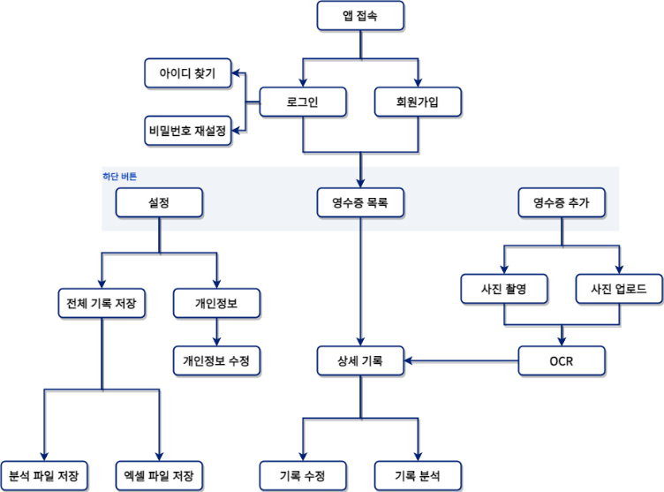
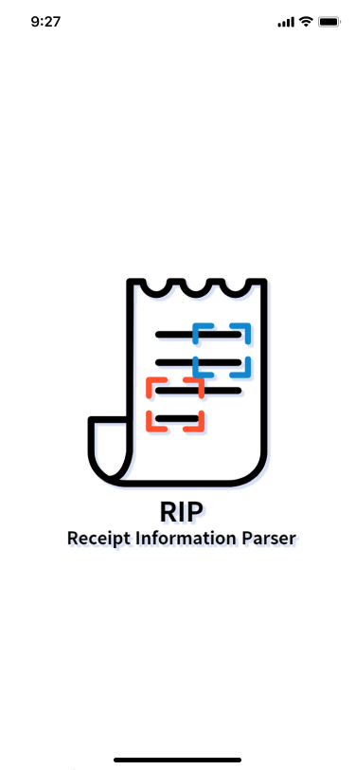
Flow Diagram
& User Interfaces

Slide 9
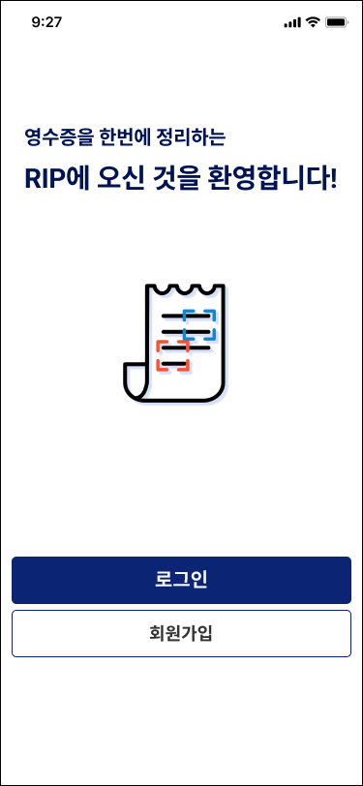
Flow Diagram
& User Interfaces

Slide 10
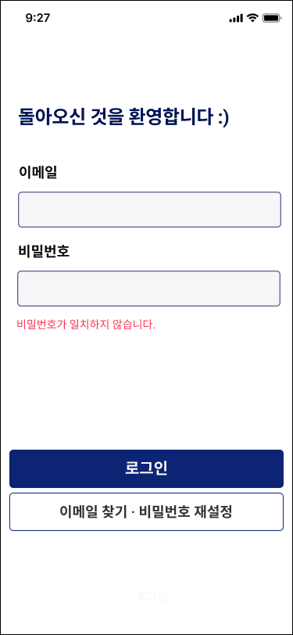
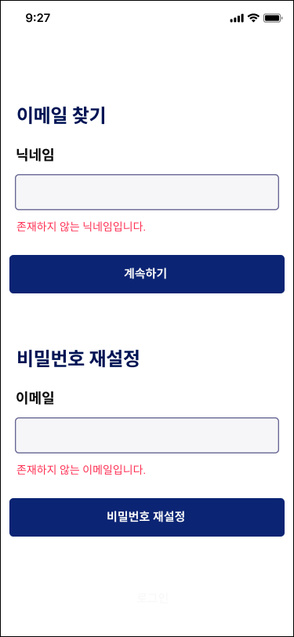
Flow Diagram
& User Interfaces

Slide 11
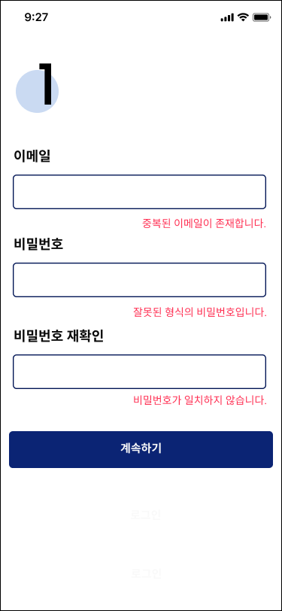
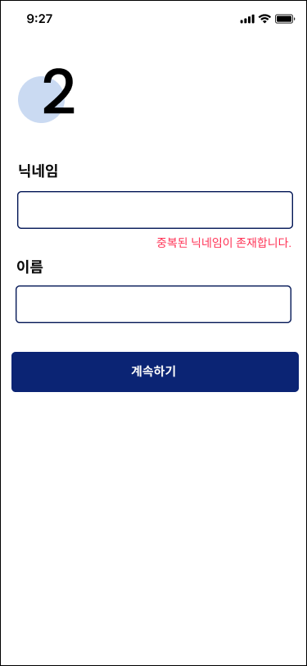
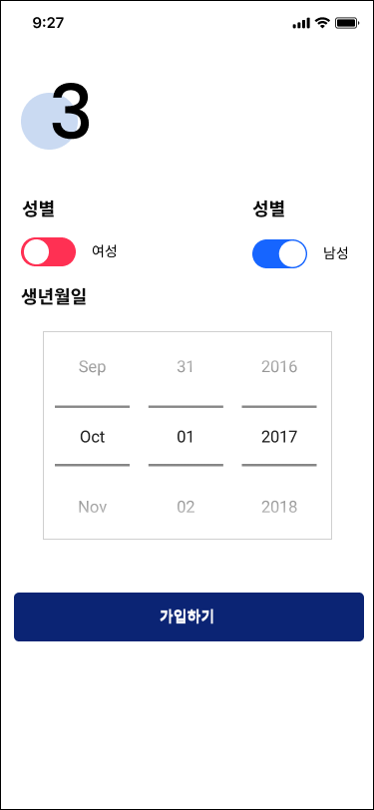
Flow Diagram
& User Interfaces

Slide 12
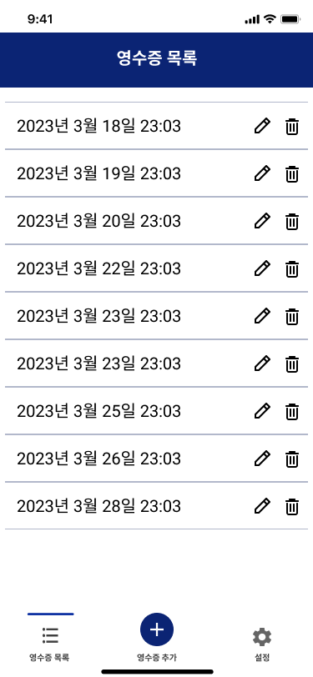
Flow Diagram
& User Interfaces
Nav Bar

Slide 13
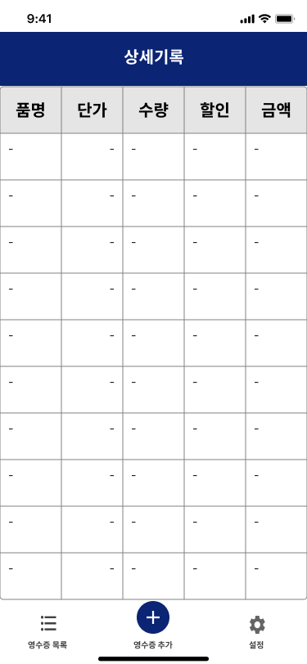
Flow Diagram
& User Interfaces

Slide 14
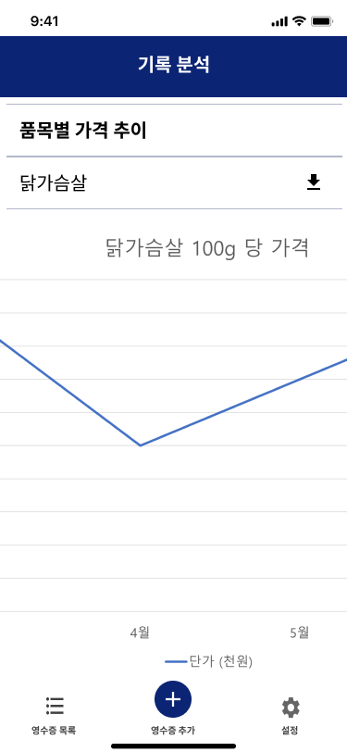
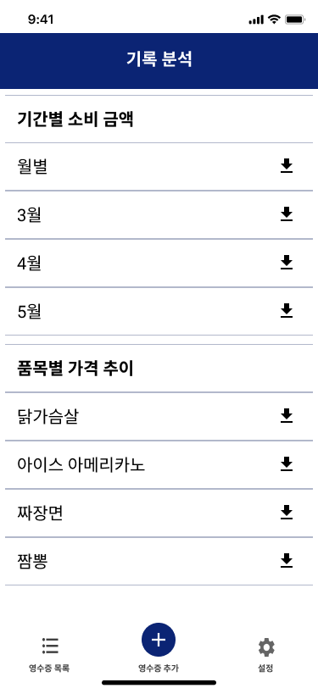
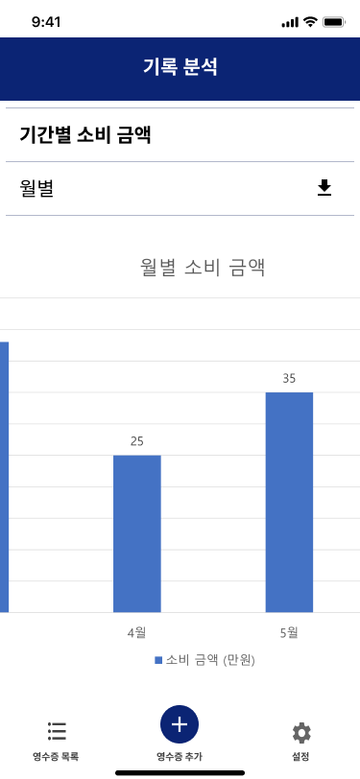
Flow Diagram
& User Interfaces

Slide 15
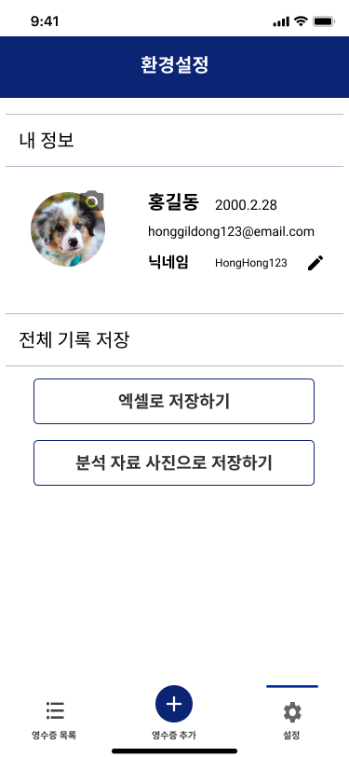
Flow Diagram
& User Interfaces

Slide 16
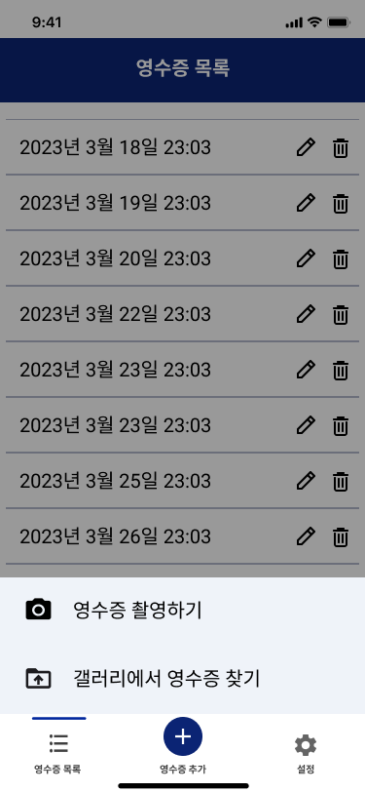
Flow Diagram
& User Interfaces

Slide 17
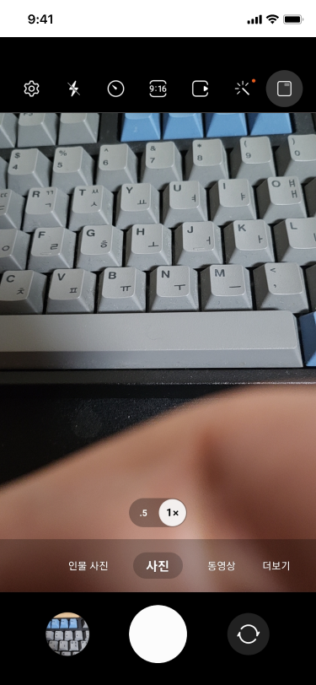
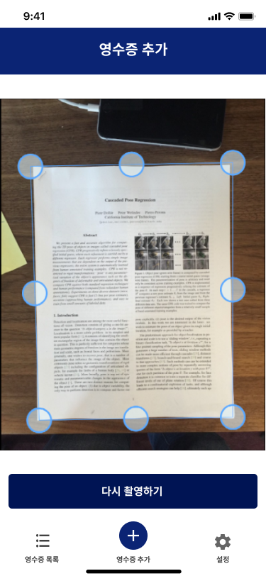
Flow Diagram
& User Interfaces

Slide 18
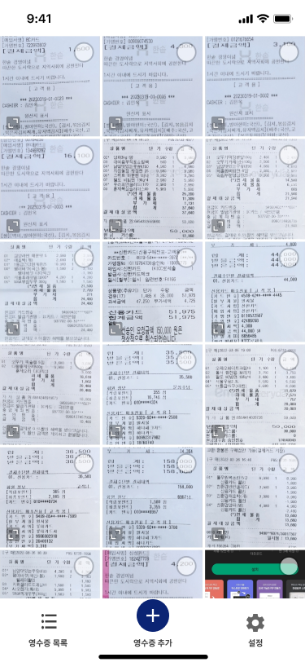

Flow Diagram
& User Interfaces

Slide 19
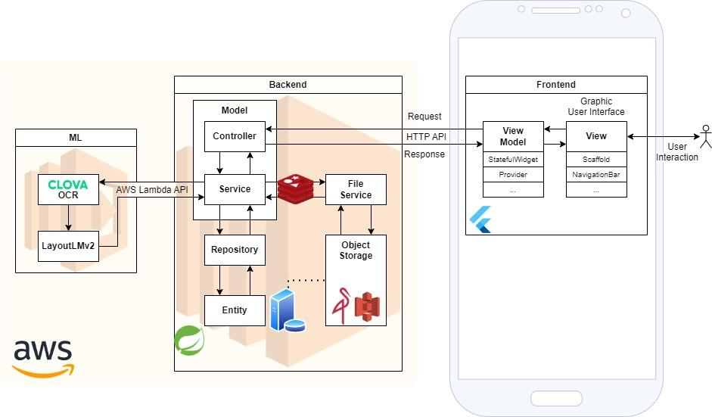
Overall Architecture

Slide 20
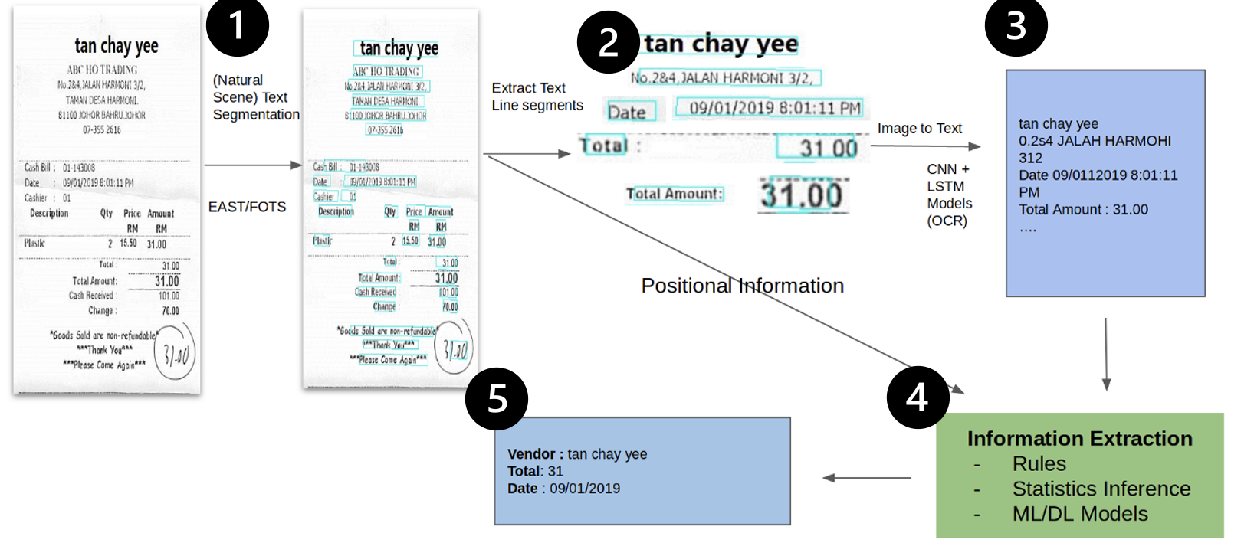
Overall Architecture
Document Specific Information Extraction
MVVM
Layered

Slide 21
Overall Architecture
Document Specific Information Extraction
MVVM
Layered

Slide 22
Overall Architecture
Document Specific Information Extraction
MVVM
Layered

Slide 23
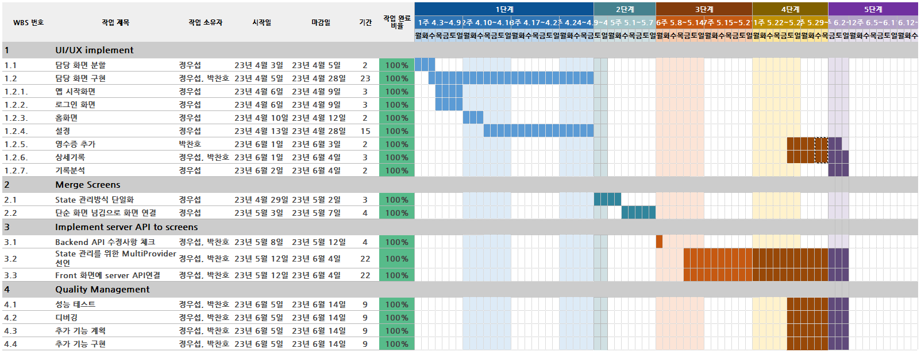
Plan & Implementation : Frontend

Slide 24
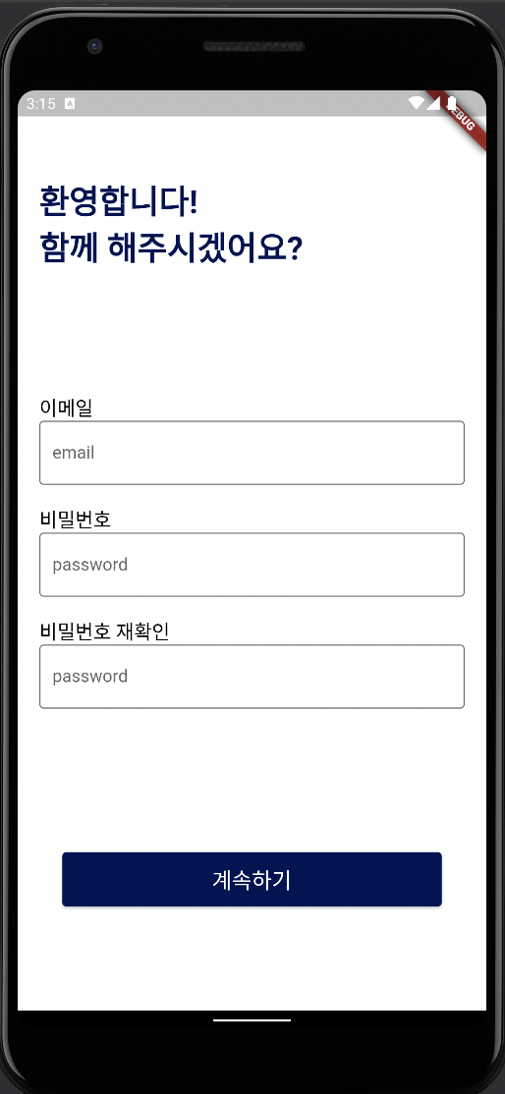
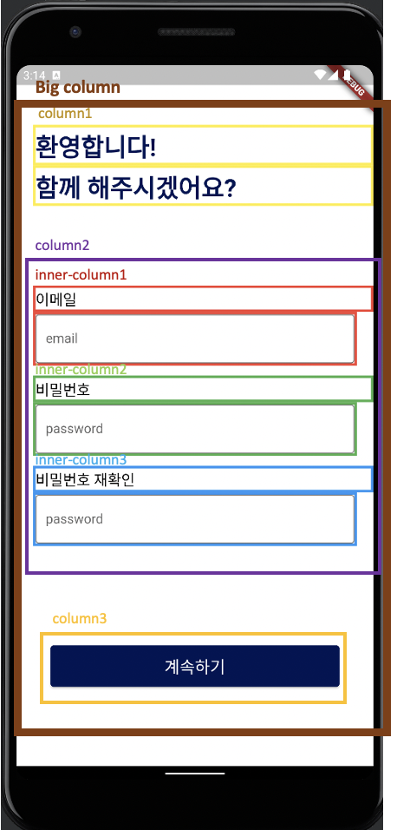
Plan & Implementation : Frontend

Slide 25
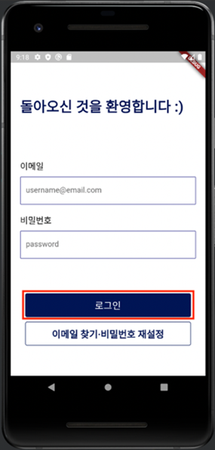
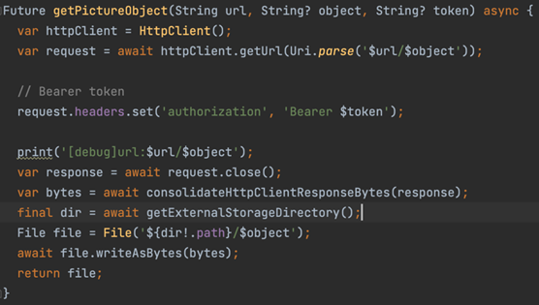
Plan & Implementation : Frontend
Asynchronously load profile image when logged in
→ avoid slow loading when showing profile image
Caching profile image for fast loading

Slide 26
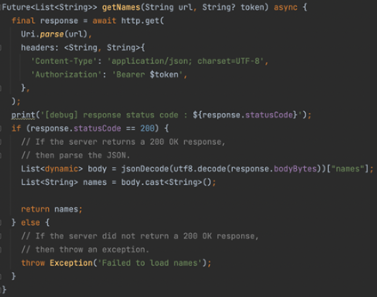
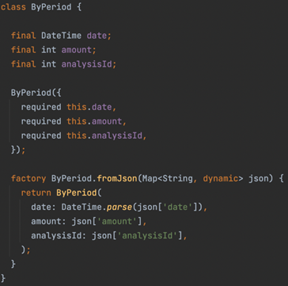
Plan & Implementation : Frontend
Request and Response using http package
Data model for each request and response

Slide 27
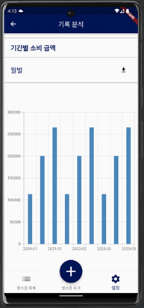
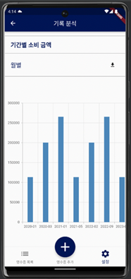
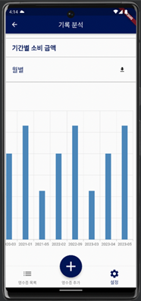
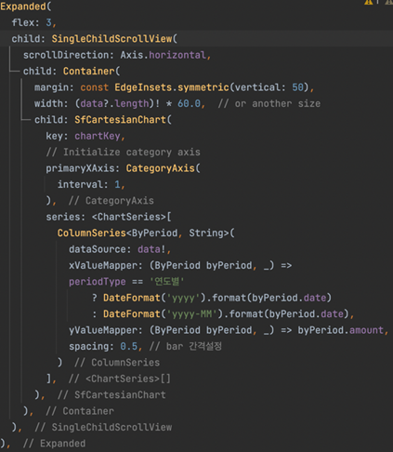
Plan & Implementation : Frontend
SingleChildScrollView (scrollable screen) for elements that causes overflow

Slide 28
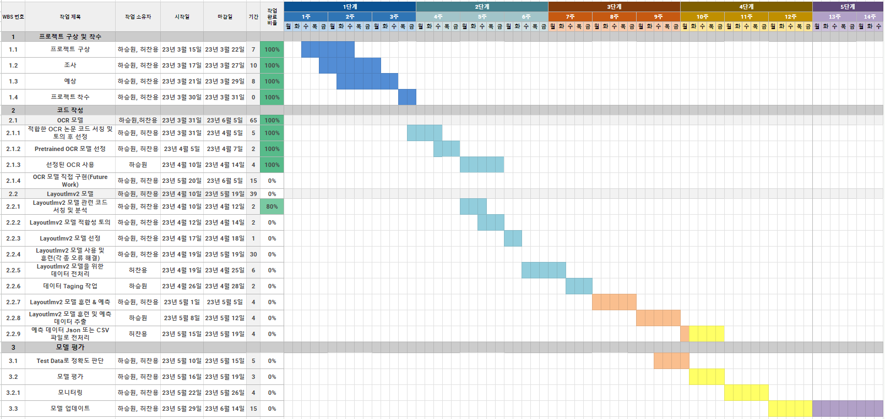
Plan & Implementation : OCR Model

Slide 29
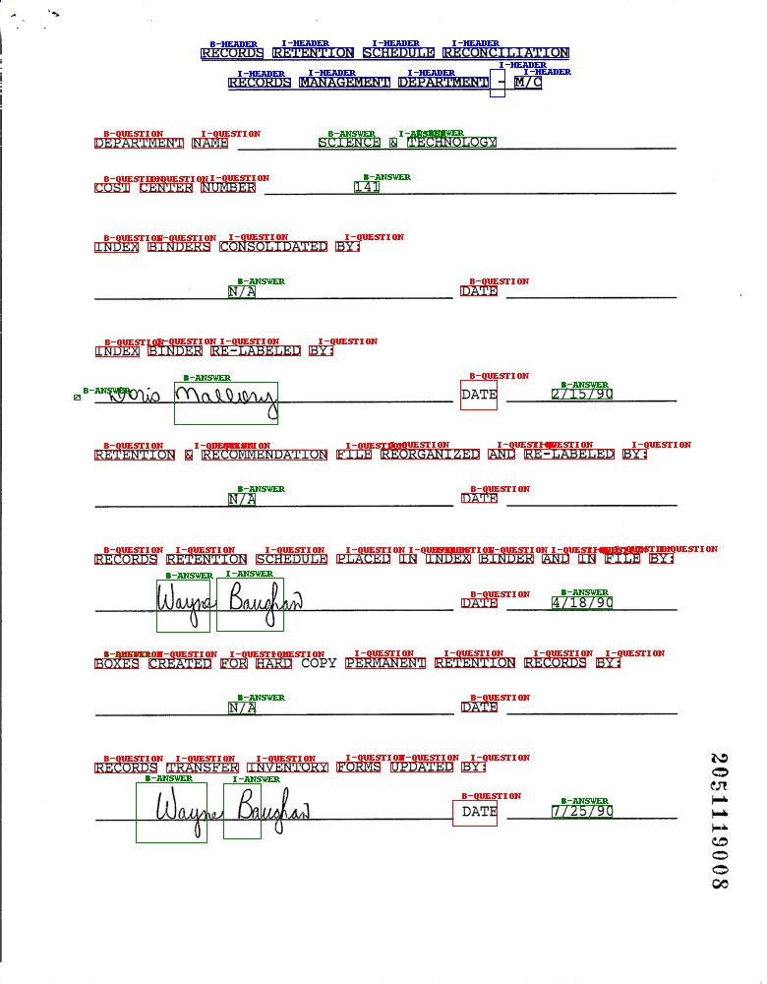
Plan & Implementation : OCR Model
Text Embedding
Transformer Layers
(Layoutlmv3)
Positional
Embedding
Notes:
이 모델의 프로세스는 다음과 같습니다: 이미지를 OCR API를 활용하여 텍스트의 위치 정보와 텍스트 자체를 추출합니다. 추출된 텍스트와 위치 정보는 임베딩 작업을 통해 수치화됩니다. 임베딩된 데이터는 모델의 입력값으로 사용되어 학습과 예측을 위한 데이터로 활용됩니다. 최종적으로 Layoutlm 모델은 이 데이터를 바탕으로 텍스트의 위치와 레이어 정보를 예측하여 문서나 이미지의 레이아웃 정보를 추출합니다.

Slide 30
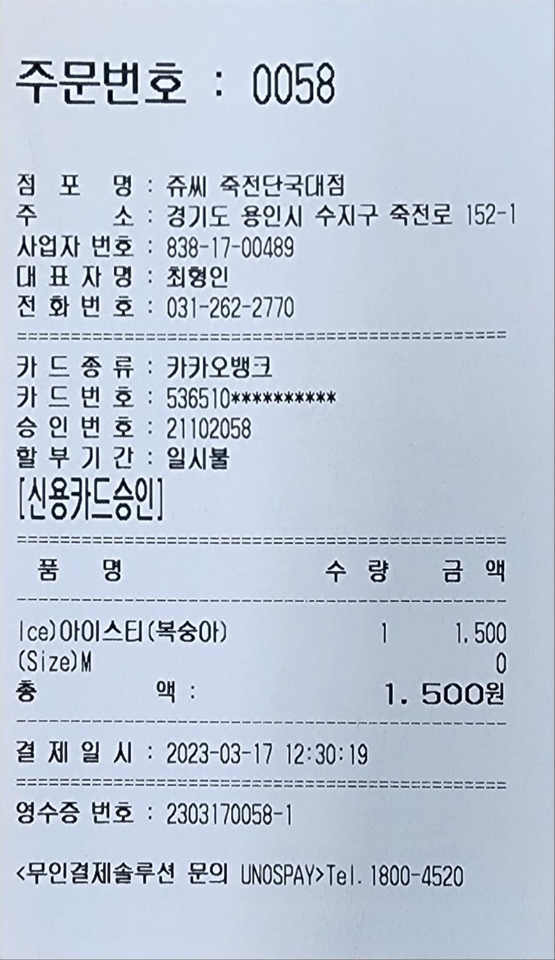
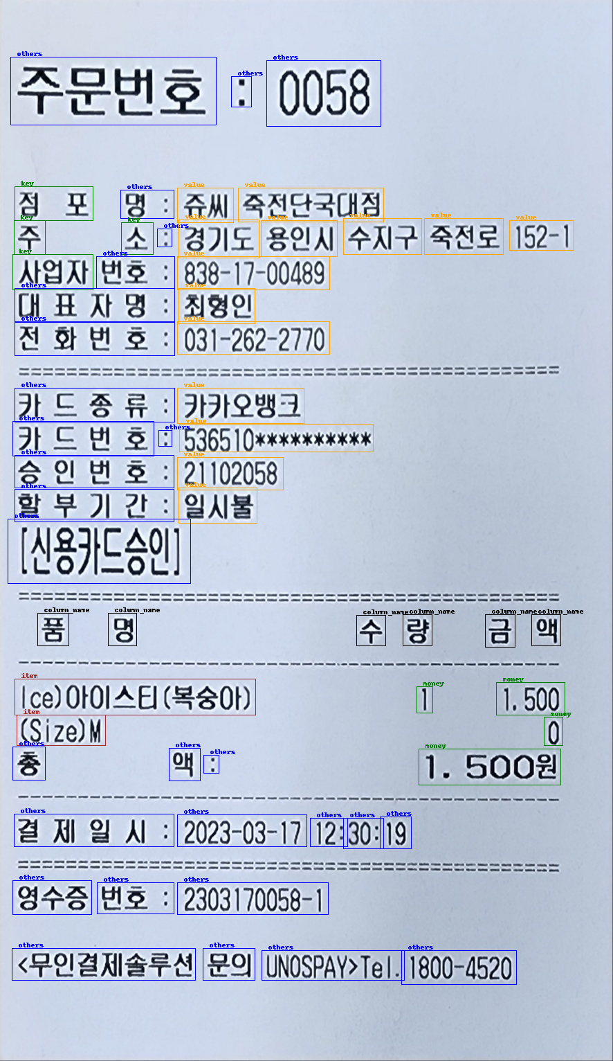
Plan & Implementation : OCR Model

Slide 31
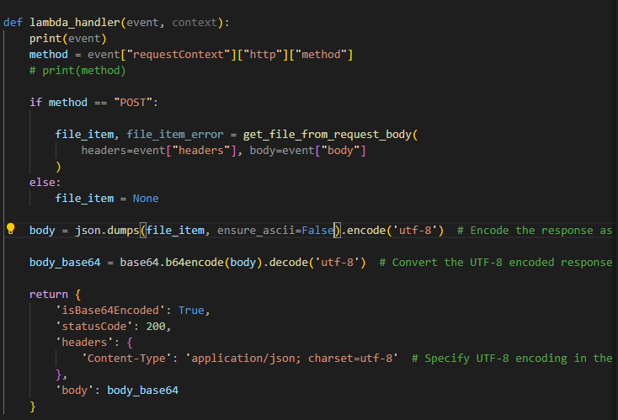
Plan & Implementation : OCR Model
Handling request from backend
Send to OCR Model
Response

Slide 32
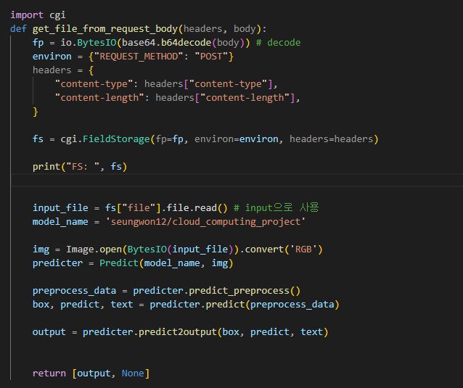
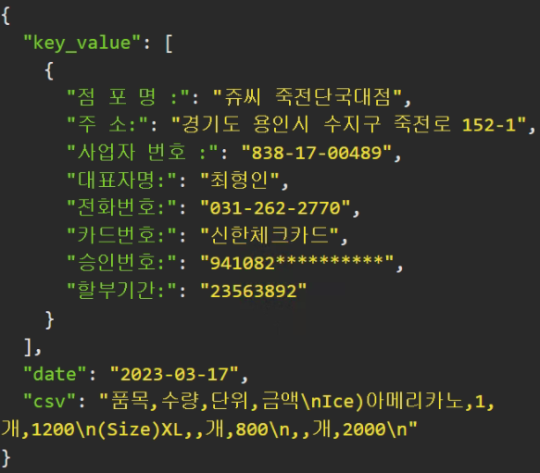
Plan & Implementation : OCR Model
Get bounding box from Naver CLOVA OCR API and preprocess image for prediction
Predict using preprocessed bounding box
Postprocess output for tabular data

Slide 33
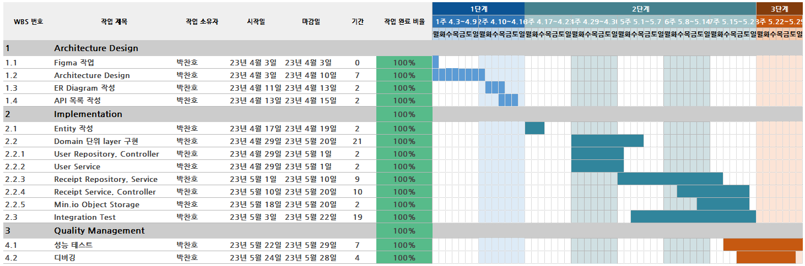
Plan & Implementation : Backend

Slide 34
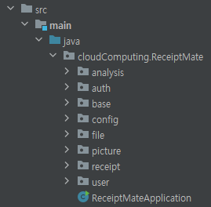
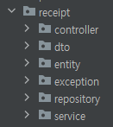
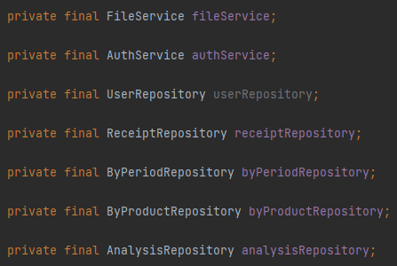
Plan & Implementation : Backend
Loosely applied DDD(Domain Driven Design)
File Tree is arranged by Domain
Each domain holds layered architecture
The service of a domain refers other domain by using repository
Main logic (service) not depending on other domain’s logic (service)

Slide 35
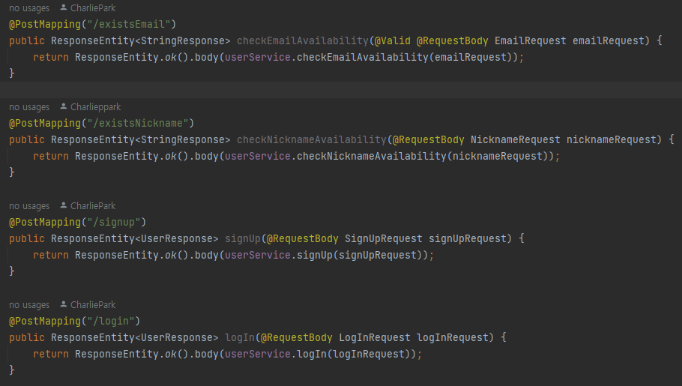
Plan & Implementation : Backend
Controller
Only handles handling request, validation, and response at endpoint
Not containing main logic

Slide 36
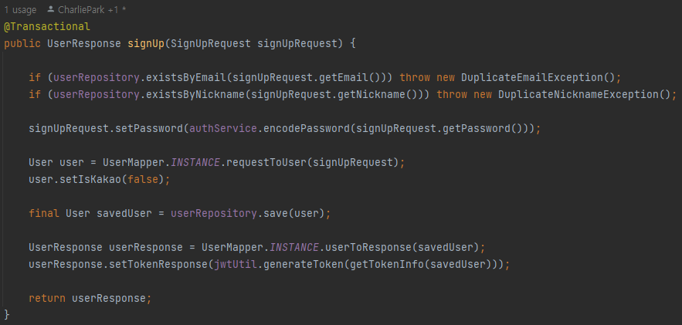
Plan & Implementation : Backend
Service
Handles main logic of the domain

Slide 37
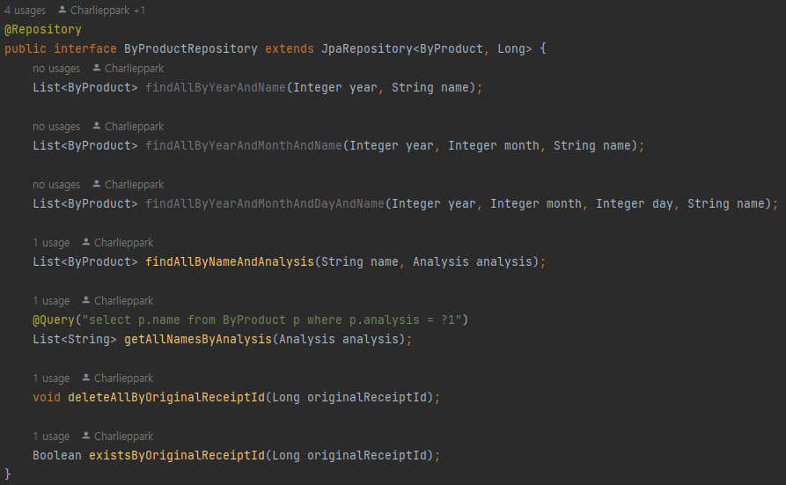
Plan & Implementation : Backend
Repository
Handles communication with DataBase

Slide 38

Plan & Implementation : Backend
Entity
Object that represents table in DB

Slide 39

Plan & Implementation : Backend

Slide 40

Plan & Implementation : Backend

Slide 41



Deployment to Cloud : OCR Model
Deployment to AWS Lambda
Serverless
Deployment using Docker Image
Lambda handler function as explained in Implementation part
Docker file for building Docker image
Required packages of python

Slide 42



Deployment to Cloud : OCR Model
Build and deploy by AWS SAM Open Lambda function URL to public

Slide 43



Deployment to Cloud : OCR Model
Input
Model Output
Lambda Output after Postprocess

Slide 44

Deployment to Cloud : Backend
Deployment to AWS EC2 : t2.micro
1 vCPU (1 physical core), 1 GiB ram
Stably running on t2.micro instance for 2 weeks
Without shutting down because of lack of memory (27.7 ~ 80% of memory)

Slide 45


Deployment to Cloud : Backend
Set Inbound rules to open port 9999 (minio), 19983 (HTTP API)
API Server running on http://3.34.124.43:19983/

Slide 46

Deployment to Cloud : Backend
Not configuring CI / CD
Running on nohup (no hang up) and & (background)
Log is managed by nohup.out

Slide 47

Demo : SignUp

Slide 48

Demo : Login

Slide 49

Demo : Kakao Authetication

Slide 50

Demo : AddReceipt

Slide 51

Demo : Receipt Detail

Slide 52

Demo : Analysis

Slide 53

Demo : Settings

Slide 54
Test Result
Endpoint | Domain | Type | Result | Notes
Backend | User | Integration | Pass | Logic of finding login email should be revised for security
Backend | Receipt | Integration | Pass | Updating needs delete and recreate, so it should be more robust
Backend | Picture | Integration | Pass
Backend | File | Integration | Pass | Save functions should be refactored
Backend | Analysis | Integration | Pass
Frontend | User | E2E | Pass
Frontend | Receipt | E2E | Pass
Frontend | Analysis | E2E | Pass
Frontend | Settings | Integration | Pass | Logic of profile images should be revised for multi device
OCR Model | Model | Integration | Pass | Postprocessing should be enhanced for receipts with complexity.
OCR Model | Lambda | E2E | Pass

Slide 55
Conclusion
1. Implementation result
Implemented all planned functions. All tests passed.
2. Future work
Still exists some future works for user-friendly services. Complex editing functions, showing more information that are captured from receipts, etc.

Slide 56
Thank you for listening

